Slide 1
What are keyframes?
And how do I use them?

Slide 2
A short diversion into Premiere
How to use keyframes to control motion, size, and the intensity of various effects
All keyframes do is mark the start and the stop of something – they are a “snapshot” of the values at that moment in your timeline

Slide 3
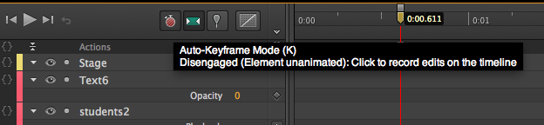
What MAY have been going wrong
In Adobe Edge, just above the timeline and next to the Toggle Pin, are two little buttons.
Auto-Keyframe
Auto-Transition

Slide 4
What do these do?
Auto-Keyframe: creates keyframes every time you change something on the stage. So. If you’re clicking and dragging stuff around and you’re not paying attention to where your playhead is – you start generating lots of keyframes all over the place, and your timeline gets messy.
SOLUTION: Start all over again.

Slide 5
Auto-transition
Otherwise known as “easing.” This creates a slow transition from one state to the other.
EXAMPLE: If you have a square 100px high at 1 second and 500px high at 2 seconds – the transition makes it seem to grow.
Without a transition, it just – BOING! – changes size.

Slide 6
In your video-editing…
Use keyframes, easing, etc. to make your transitions smoother
To adjust the intensity of effects over time
HINT: You can also import effects from Photoshop to Premiere to change the look of your shots (the “Instagram Effect”)

Slide 7
Toggle Pin
“Is a way of pinning the current state of element properties to a certain time, while using the Playhead to determine at which time the animation should complete. The Pin can be positioned either before or after the time indicated by the Playhead—but it always indicates a starting point for the animation, with the Playhead indicating the end. Changing any element properties while the Pin is unsynced will create animation of those properties beginning at the Pin and ending at the Playhead position.”

Slide 8
Troubleshooting the Pin
When the Pin has been activated, the direction of animation is indicated through a colored strip of chevrons on the Timeline. The color will be yellow or blue, depending upon the direction of motion; blue indicates motion to the left of the Pin, while yellow indicates motion to the right of the Pin.

Slide 9
Adding “Triggers” to Your Animation

Slide 10
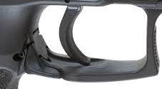
What is a “trigger”?

Slide 11
No!
A trigger is how we add interactivity to our pages:
Clicking an HTML link to take us to another page
Moving cursor over an image to make it swap
Click/tap/swipe to cause an animation to play

Slide 12
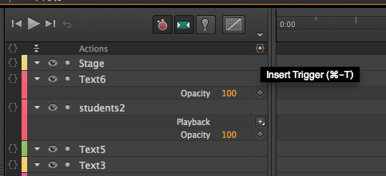
Back to Edge Animate…
With the playhead at .5 second or so, click on this tiny button next to “Actions” down on your timeline

Slide 13
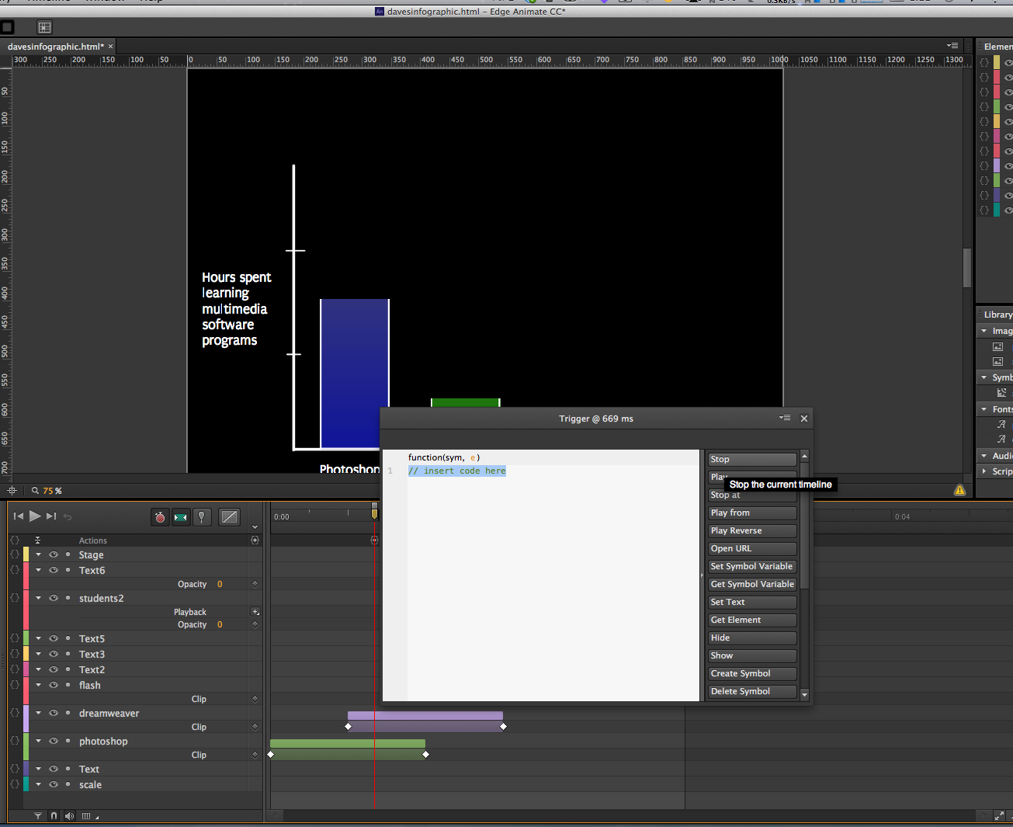

Slide 14
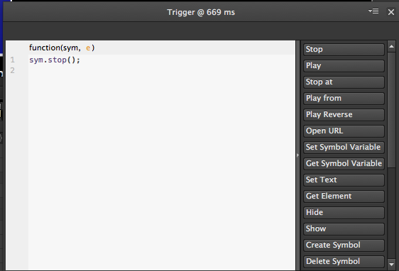
Click on Stop.

Slide 15
Test your animation
CMD+Enter
File ➔ Preview in Browser
Your animation should get to where you put the stop command – and then stop.

Slide 16
Make it start again
Click on one of your bars. You should see the layer get highlighted on:
The Timeline
The Stage
The Elements panel

Slide 17
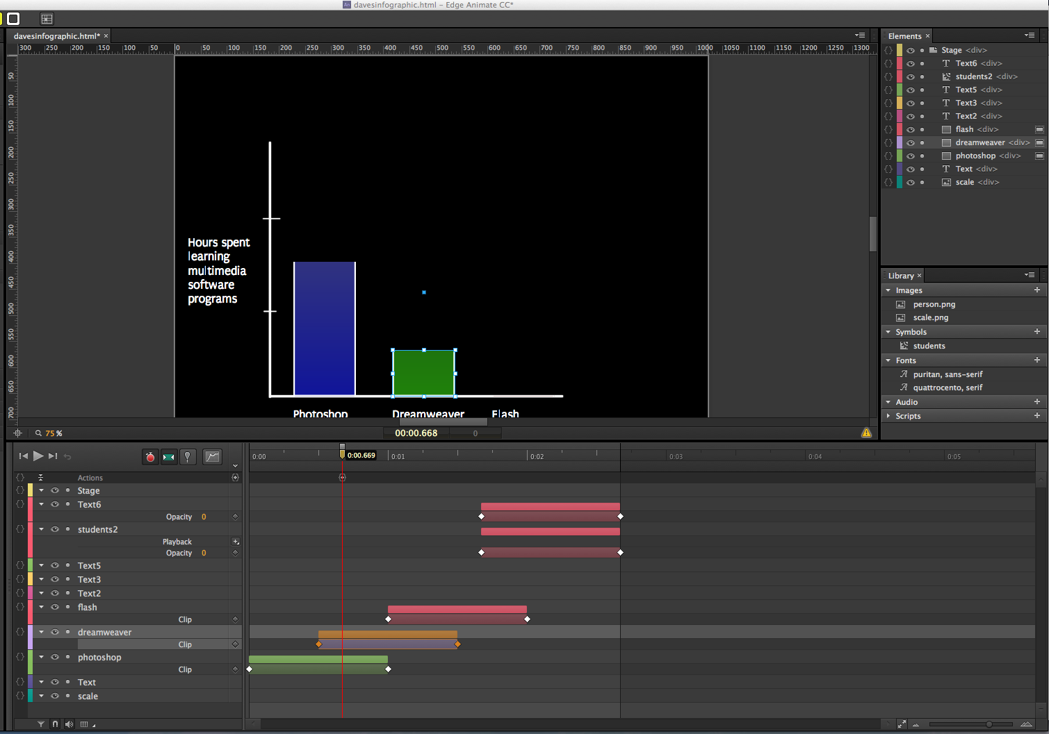

Slide 18
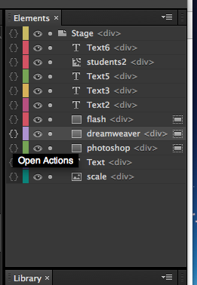
Time to add an action
Up in the Elements panel, click on the little brackets next to the name of the layer you just selected

Slide 19
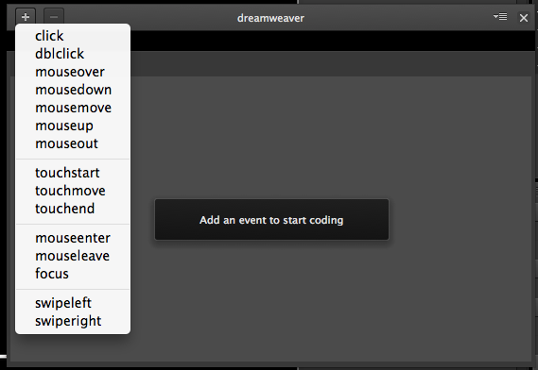
Click the “+” in the upper left

Slide 20
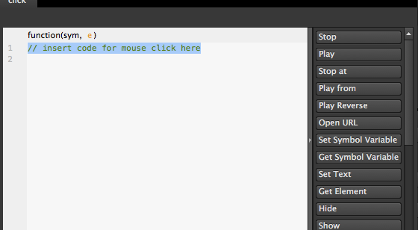
Click on Play

Slide 21
Close panel, test animation
Here’s what SHOULD happen:
Your animation should start to play, and then stop.
When you click on the layer that you added the action to – the animation starts playing again.

Slide 22
Start playing with actions
Suggestions:
Mouseover
Open URL
Play backwards

Slide 23
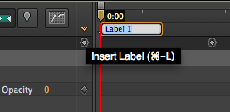
Make animation cycle
Adding Labels – with Playhead at the far left (i.e. the very start) of your animation, click on the tiny little down triangle, above trigger

Slide 24
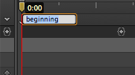
Type in “beginning”

Slide 25
Move playhead to end
Click and drag the playhead to the very end of your animation.
Click on “Trigger” again

Slide 26
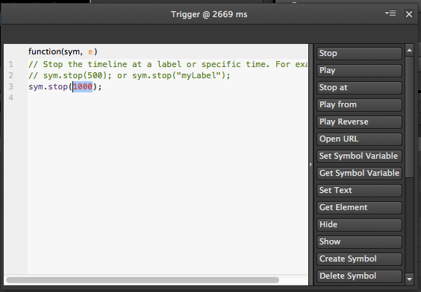

Slide 27
Click on “Play from”
Type in the word “beginning” – YES, YOU NEED TO HAVE THE QUOTE MARKS IN THIS TIME!!

Slide 28
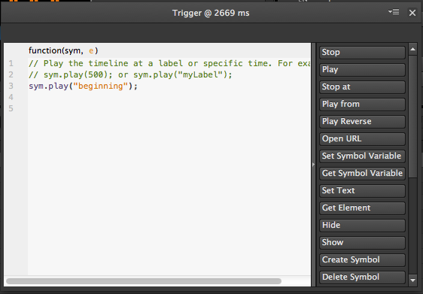

Slide 29
Test your animation again
It should go through the sequence, hit the end, and then cycle back to the beginning
ADVANCED: Click and drag the label around on the timeline.

Slide 30
Assignment 1: Start working on Midterm
Multimedia / Story Package 1
Minimum 800 words and one two-minute Webby element. Both must relate to your beat (if you have one) and located within your district.
More details: http://elprofe.me/usc/2014/spring/518/midterm/ Post the URL to blog post’s comments.
Deadline: Thursday, March 13 9AM

